Slide 1

DevOps Chatbot for Alerts

Slide 2
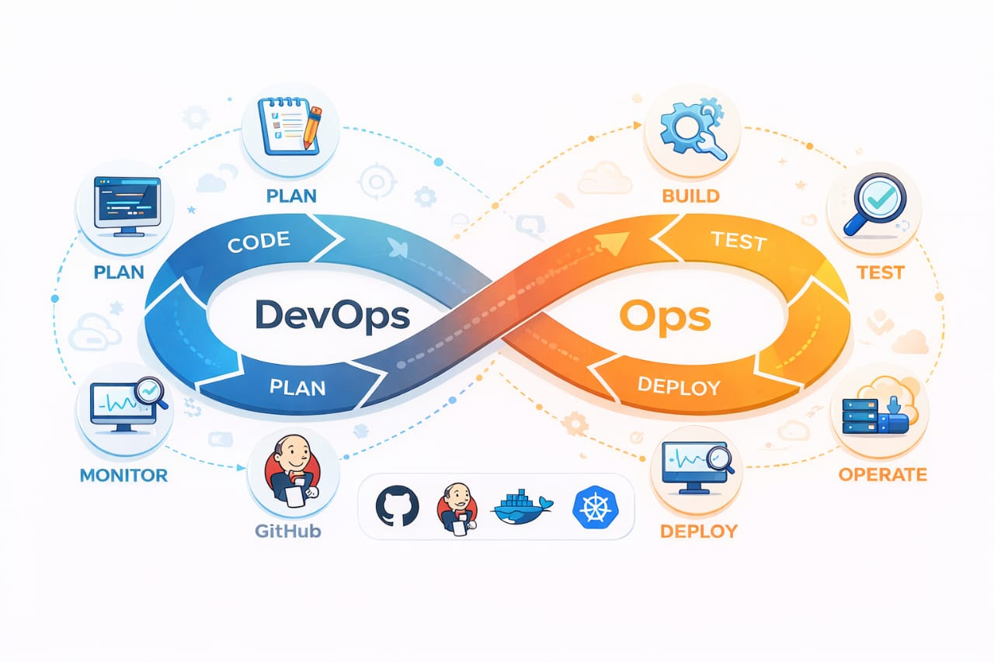
Introduction
DevOps is a combination of Development and Operations used to automate software delivery.
In DevOps, CI/CD pipelines and servers must be continuously monitored.
Manual monitoring is difficult and time-consuming for engineers.
Chatbots can automate communication and provide instant notifications.
This project proposes a chatbot-based alert system to notify DevOps teams in real time using Telegram or Slack..

Slide 3
Problem Statement
DevOps engineers need to manually monitor CI/CD pipelines like Jenkins and GitHub Actions.
Manual monitoring is time-consuming and inefficient.
Engineers may miss build failures or server downtime due to continuous workload.
Delayed detection of issues can cause system outages and service disruption.
Manual checking increases the risk of human errors.
There is no instant real-time notification system in the traditional monitoring process.
Therefore, an automated chatbot-based alert system is required to notify DevOps teams in real time.

Slide 4
Proposed Solution
Design a chatbot integrated with CI/CD pipelines like Jenkins or GitHub Actions.
Use a Python-based alert system to detect build status and server issues.
Automatically send notifications to Telegram or Slack using Bot API.
Provide real-time alerts for build success, build failure, and server downtime.
Reduce manual monitoring by automating the alert process.
Improve response time and system reliability in DevOps operations.

Slide 5
Project Objectives
The objective of this project is to design a chatbot-based alert system that integrates with CI/CD pipelines.
It aims to automate notifications, reduce manual monitoring, and improve system reliability and response time in DevOps environments.

Slide 6
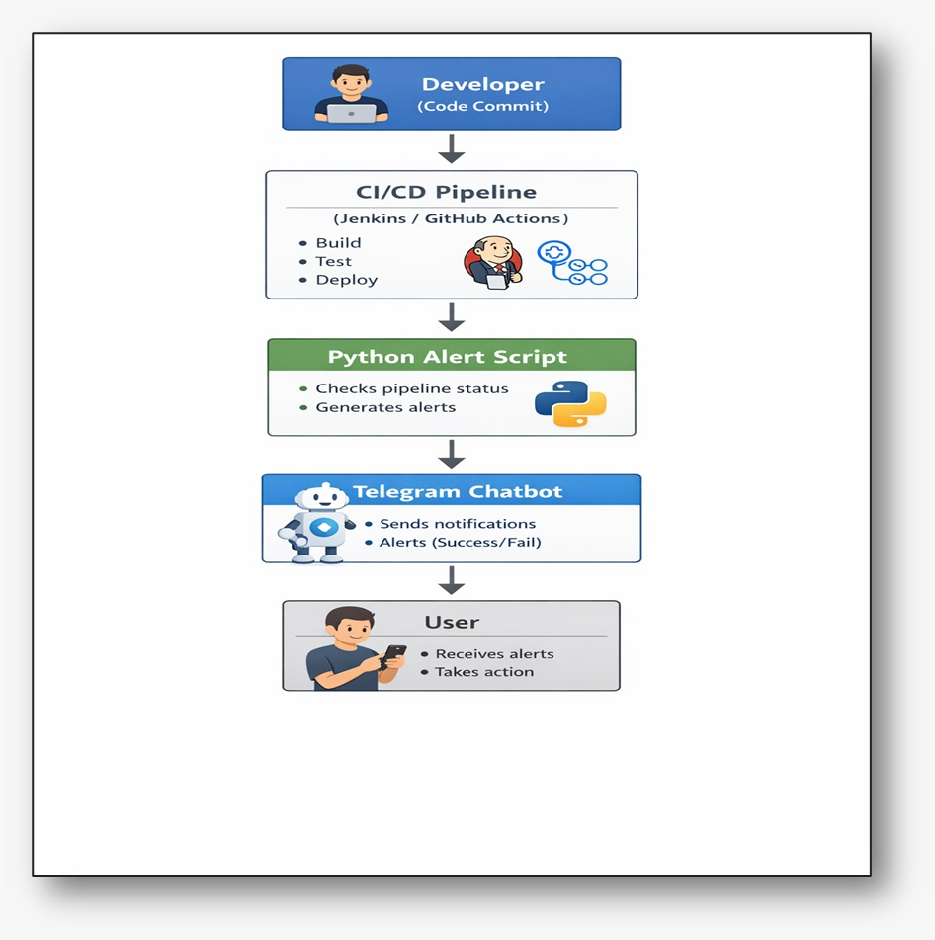
System Architecture

Slide 7
Tools & Technologies
Python: for scripting the alert system
Telegram API: for chatbot communication
Jenkins or GitHub Actions: for CI/CD pipeline
Git and Linux: for version control and system operations
Docker: can be used for containerization in future implementation.

Slide 8
Features
Real-time notifications for build success and build failure
Server downtime and system error alerts
Automated message delivery using Telegram chatbo
CI/CD pipeline integration with Jenkins or GitHub Actions
Python-based alert triggering system24/7 automated monitoring without manual checking.

Slide 9
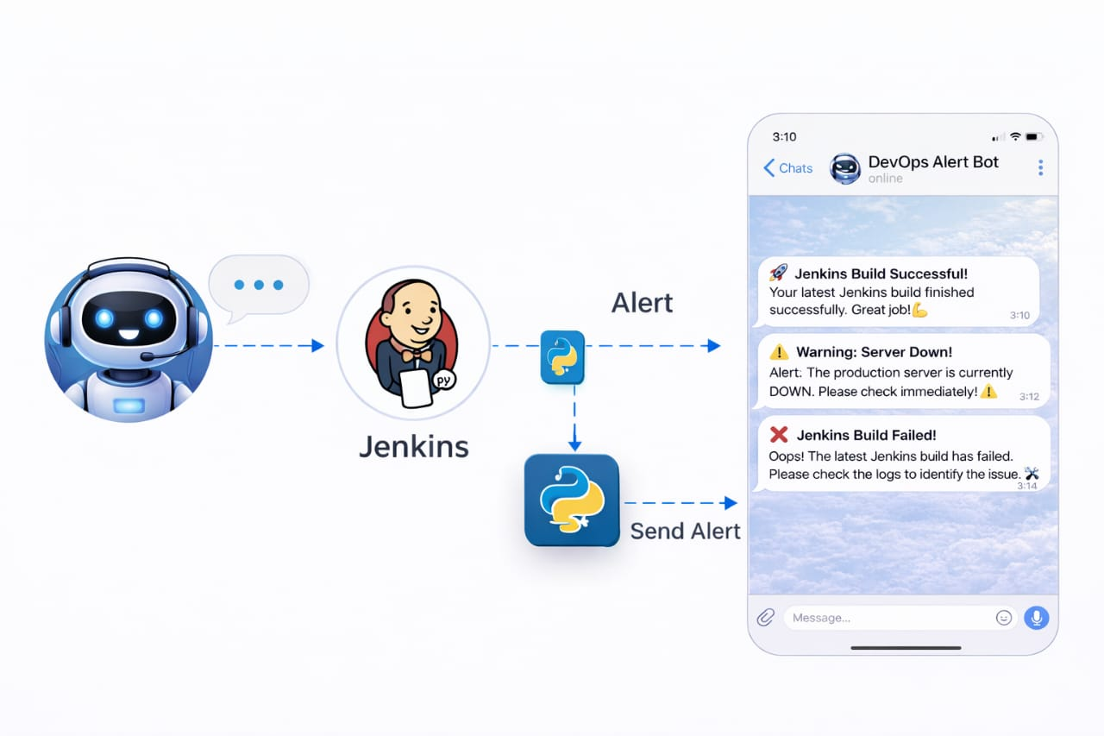
Result

Slide 10
Conclusion
In future, this project can be enhanced by integrating Slack and Microsoft Teams, creating a monitoring dashboard, and adding Al-based anomaly detection.
Conclusion: This proposed project demonstrates the concept of automating DevOps monitoring using chatbots. It aims to reduce manual effort and improve system reliability through real-time alerts.

